Slide 1
Bootcamp
Machine Learning

Slide 2
Patrick Staudt, CFA
Developing Python scripts for astrophysics research since 2017
VBA since 2011
A stint of C++ in 2008
Ph.D. student, Physics, UC Irvine, 2026
B.S., Astrophysics, Rutgers, January 2020
B.S., Management, UConn, May 2010

Slide 3


Slide 4

Class Goals
Theory behind important ML algorithms
Practice building models with scikit-learn

Slide 5
Theory
Concepts & terminology
Intuition behind underlying math
Understand tradeoffs between types of machine learning models

Slide 6
Practice
Machine learning workflow
Diagnosing common problems
Steps to improve different types of models

Slide 7
Class format
15 minutes for lecture & demo
15 minutes for exercises
Pause to review & ask questions
Rinse and repeat

Slide 8
3 Myths about Machine Learning

Slide 9
Myth #1:
“Machine learning is new”

Slide 10
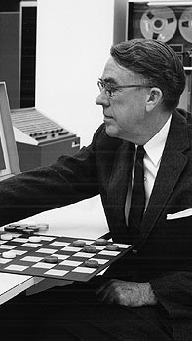
“The field of study that gives computers the ability to learn without being explicitly programmed”
- Arthur Samuel, 1959

Slide 11
Machine Learning: Why Now?
Computers are now fast and cheap
Improvements to old ideas (e.g. back-propagation)
Notes:
GPUs
Polygons => linear algebra

Slide 12
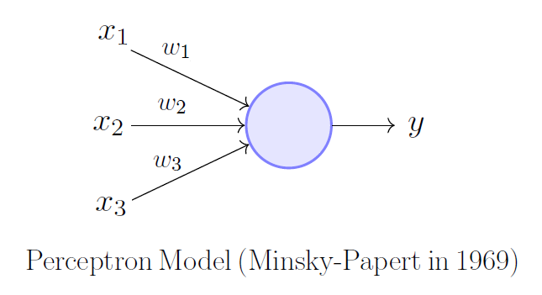
Original “neural network” was just one neuron

Slide 13
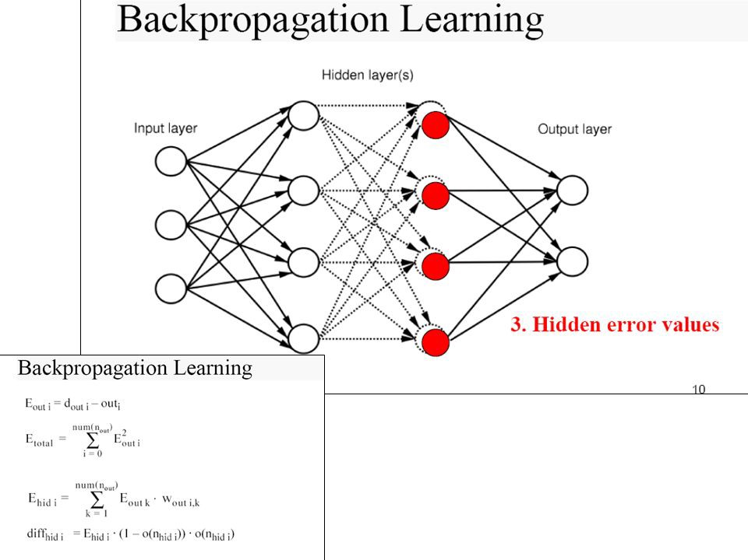

Slide 14
Myth #2:
“Machine learning = AI”

Slide 15
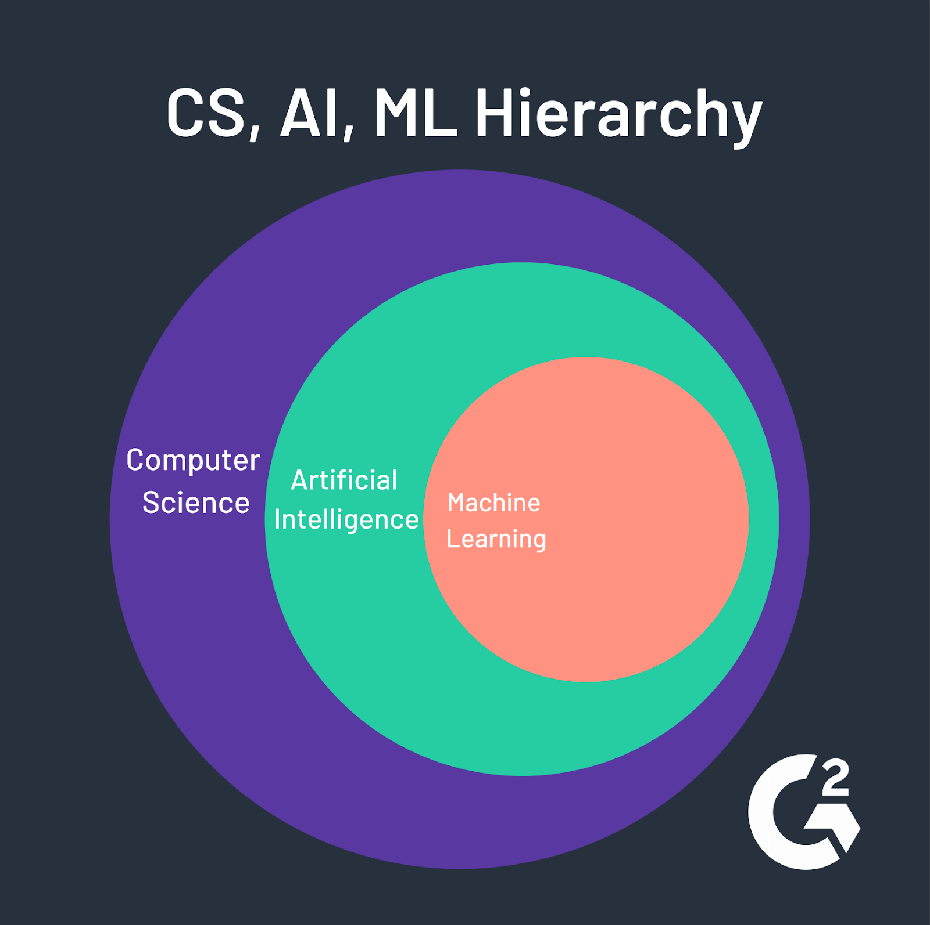
Notes:
CS: anything involving computing
AI: trying to make computers do what people do
ML: deriving patterns from data, as opposed to other approaches to AI

Slide 16
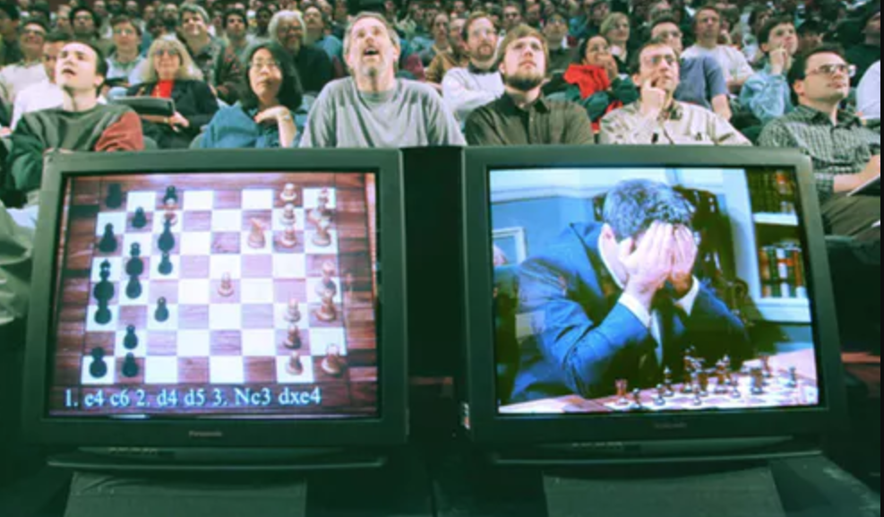
Deep Blue vs. Garry Kasparov
Intelligence = search algorithm (1956 - 1974)
Notes:
First big wave of AI
Search through all possible solutions
By using this exhaustive search, computers could do things that only humans could do previously
Deep Blue worked through all possible moves it could play
Can’t develop a general intelligence just from search algo’s
People got tired of it => AI winter

Slide 17
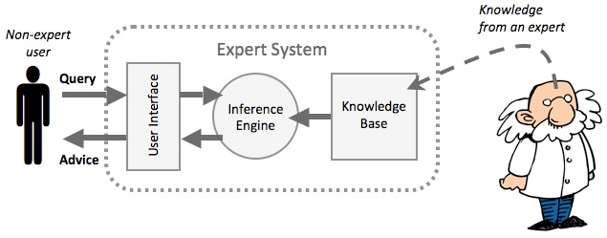
Intelligence = FACTS/RULES + Deductive Logic
(1980 - 1987)
Notes:
Combination of facts and deductive logic
Give doctors questionnaires to determine the rules they use for diagnosis
E.g. This person has a fever. They’ve been to FL recently. What might they have?
Approach worked for limited cases
Never worked out in general
https://www.google.com/url?sa=i&source=images&cd=&ved=2ahUKEwi-kIfs_cHkAhWQxVkKHYNjDYQQjRx6BAgBEAQ&url=https%3A%2F%2Fwww.itgsnews.com%2Fcreating-expert-system-with-clips%2F&psig=AOvVaw2rT1XziARmYSMHLyhFbWN6&ust=1568058074270738

Slide 18
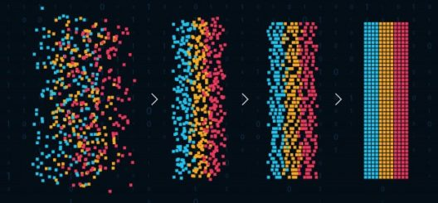
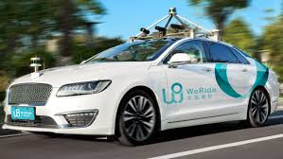
https://www.google.com/url?sa=i&source=images&cd=&ved=2ahUKEwi-kIfs_cHkAhWQxVkKHYNjDYQQjRx6BAgBEAQ&url=https%3A%2F%2Fwww.itgsnews.com%2Fcreating-expert-system-with-clips%2F&psig=AOvVaw2rT1XziARmYSMHLyhFbWN6&ust=1568058074270738
Intelligence = Pattern Recognition (1993 - today)
Notes:
Machine learning
Based on statistics, reinforcement learning
Less based on formal logic and exhaustive search algorithm

Slide 19

“If a typical person can do a mental task with less than one second of thought…
we can probably automate it either now or in the near future”
- ANDREW NG

Slide 20
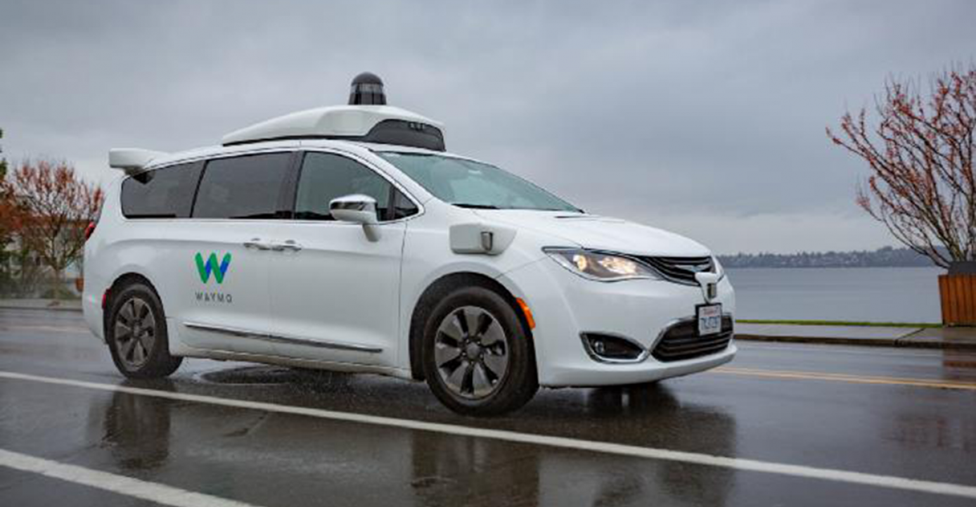
https://www.google.com/url?sa=i&source=images&cd=&ved=2ahUKEwi-kIfs_cHkAhWQxVkKHYNjDYQQjRx6BAgBEAQ&url=https%3A%2F%2Fwww.itgsnews.com%2Fcreating-expert-system-with-clips%2F&psig=AOvVaw2rT1XziARmYSMHLyhFbWN6&ust=1568058074270738
Self-Driving Cars

Slide 21
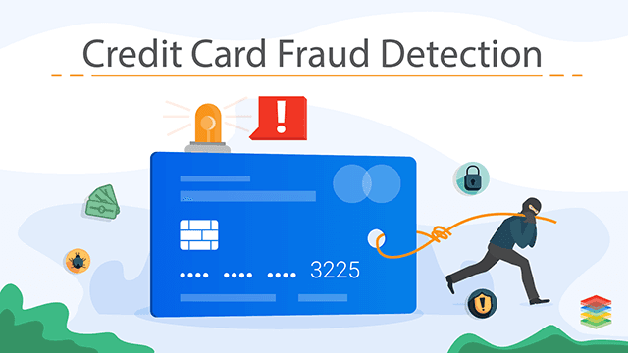
https://www.google.com/url?sa=i&source=images&cd=&ved=2ahUKEwi-kIfs_cHkAhWQxVkKHYNjDYQQjRx6BAgBEAQ&url=https%3A%2F%2Fwww.itgsnews.com%2Fcreating-expert-system-with-clips%2F&psig=AOvVaw2rT1XziARmYSMHLyhFbWN6&ust=1568058074270738
Notes:
Grandma goes to the grocery store once a week
Probably not spending $10,000 in Vegas

Slide 22
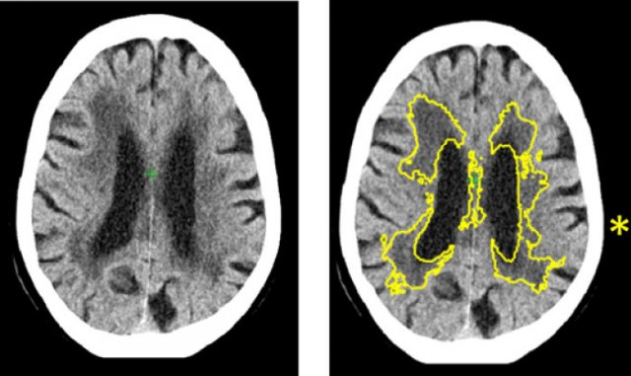
Medical Diagnostics

Slide 23
Myth #3:
“Machine learning will replace programming”

Slide 24
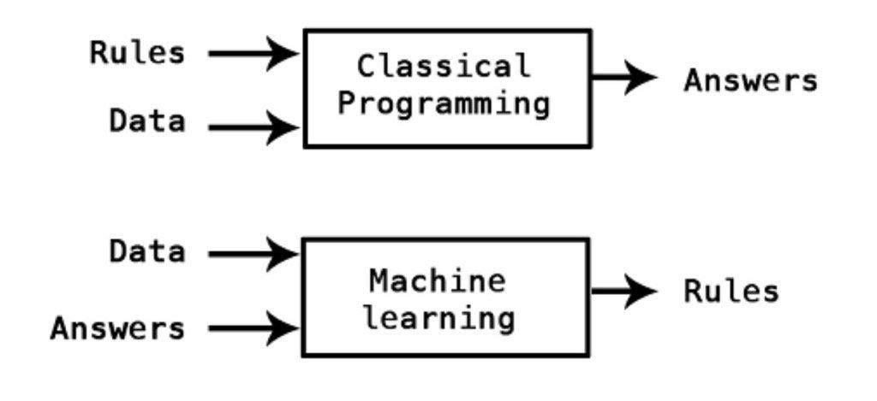
Notes:
Easier to code rules: classical
Easier to provide data and answers: machine learning

Slide 25
MACHINE LEARNING SHORTCOMINGS
Algorithms are often “black box”
Failures can be sudden and dramatic
Vulnerable to manipulation

Slide 26
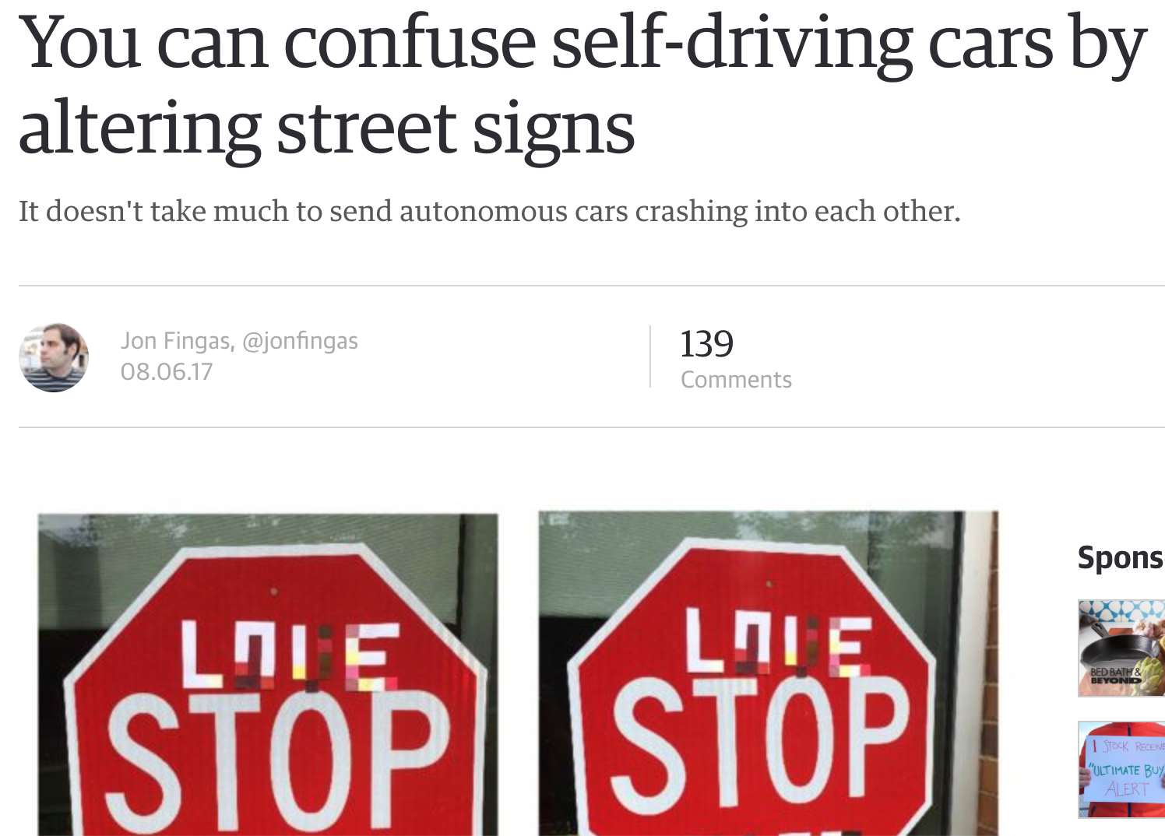

Slide 27
Concepts

Slide 28
Supervised vs Unsupervised
Supervised: model trained and evaluated based on previous “right answers”
E.g. Credit card fraud
Unsupervised: Finds patterns, with no right/wrong answers
E.g. Discovering types of retail customer we might not have known about (based on purchasing patterns)

Slide 29
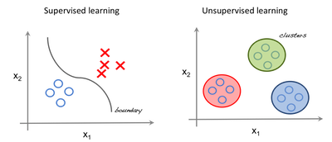

Slide 30
Regressions vs Classification
Regression outputs a number
Classification outputs a label

Slide 31
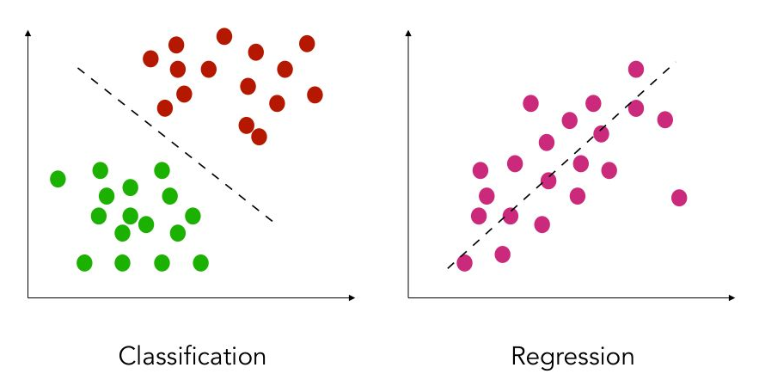

Slide 32
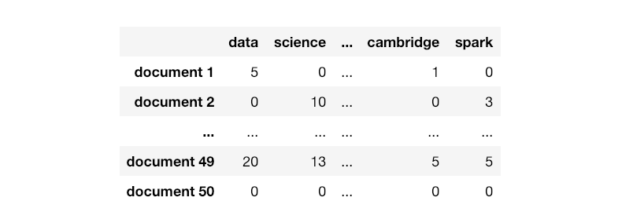
ML Assumptions
Each row must represent the same type of data
E.g.: Every row is a document

Slide 33
features
samples

Slide 34
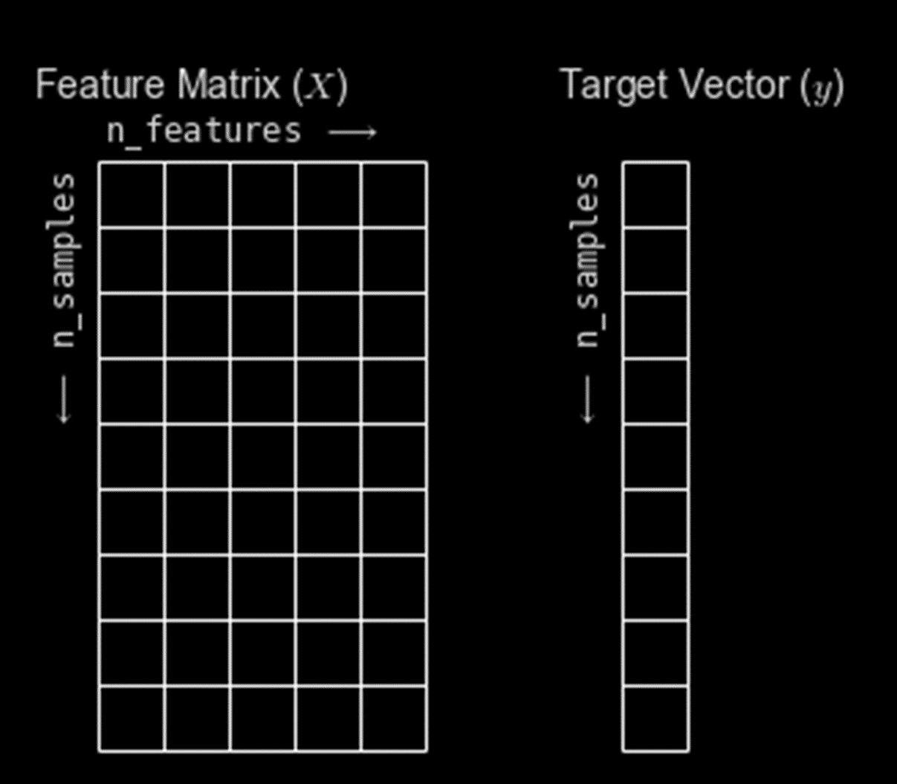
Supervised model
ANSWERS
ALL THE DATA EXCEPT THE ANSWERS

Slide 36

Wait! How do we test?
Notes:
Can’t test your model with data it’s already seen.

Slide 37
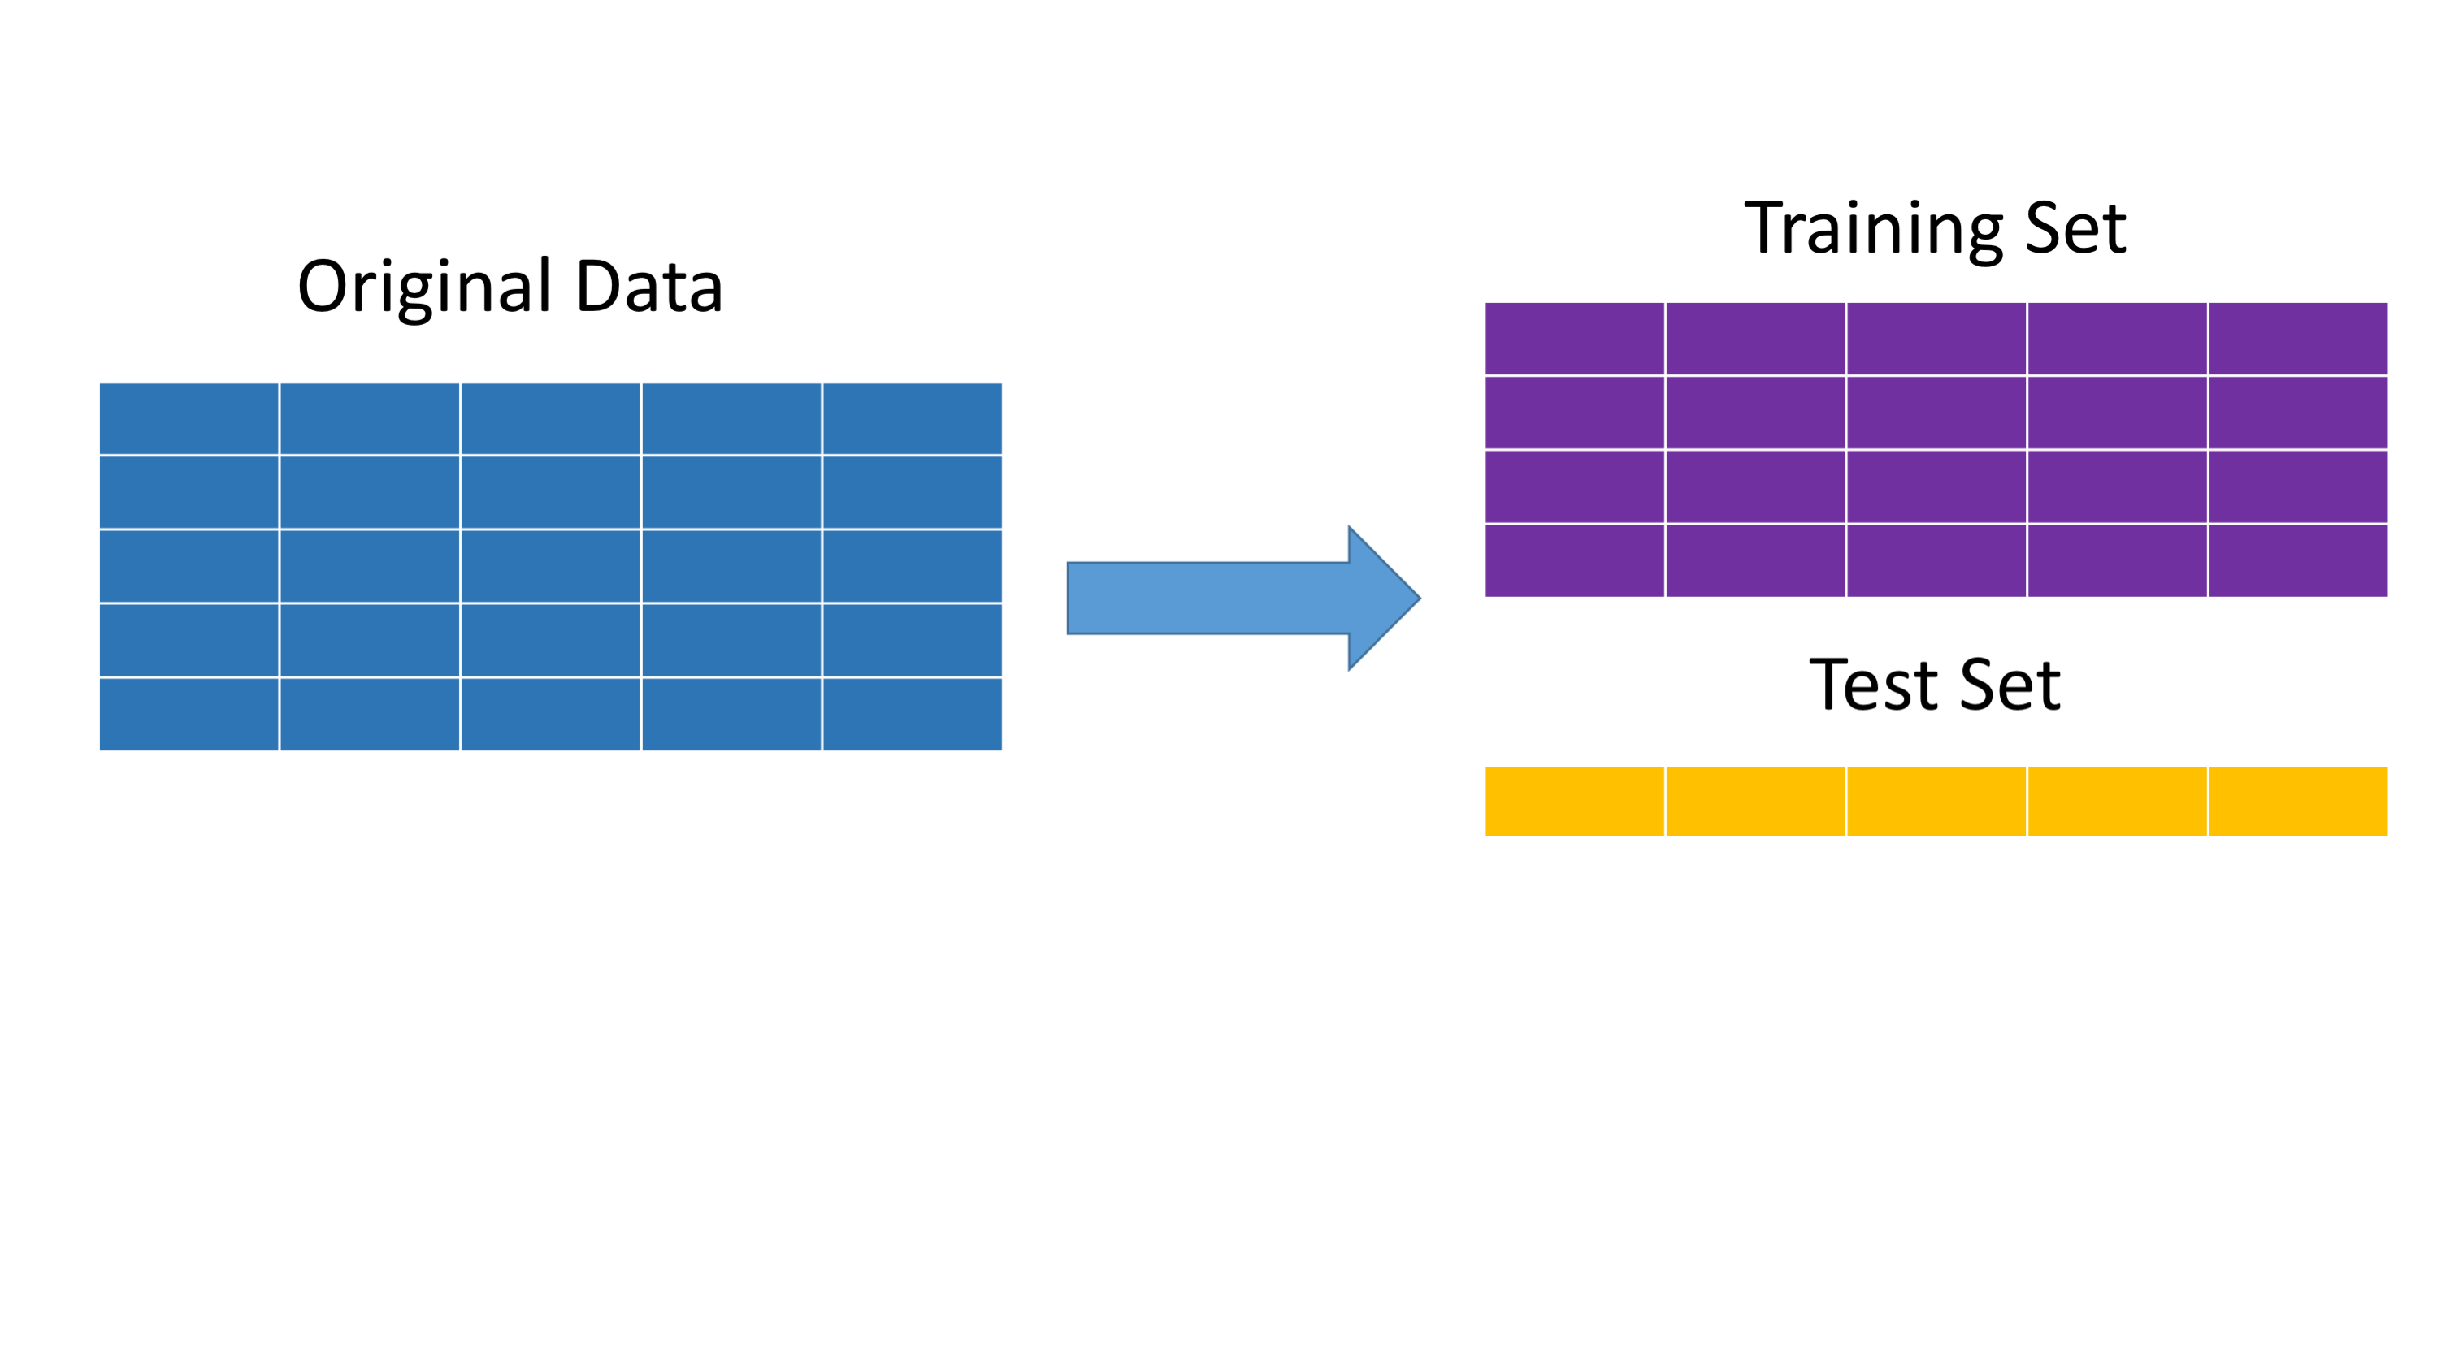
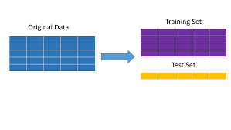

Slide 38
Quiz

Slide 39
Hands on
with Python

Slide 40
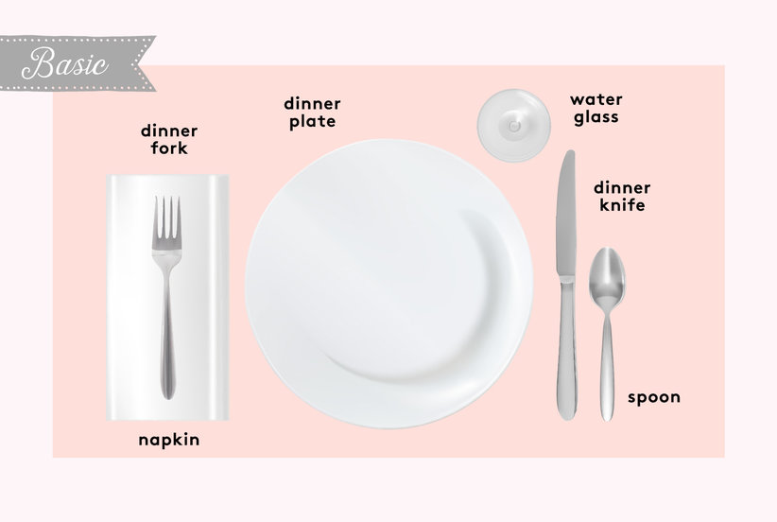
Setting the table

Slide 41
Pandas
Short for “panel data”
DataFrame concept from R

Slide 42
Dataframe
Similar to a spreadsheet
Columns are Numpy arrays with special index

Slide 43
importing Pandas
import pandas as pd

Slide 44
creating a Dataframe
df = pd.read_csv(“file_name”)

Slide 45
Grabbing a Column
df[‘profit’]

Slide 46
Dataframe from columns
columns = [‘revenue’, ‘profit’]
df[columns]

Slide 47
Dropping Columns
df.drop(columns=[‘revenue’])

Slide 48
Dividing your data
from sklearn.model_selection import train_test_split

Slide 49
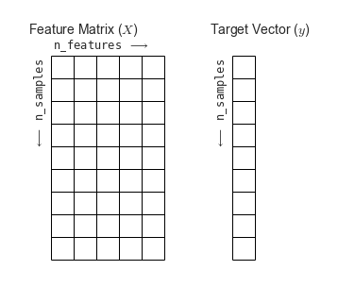

Slide 51
Dividing your data
X_train, X_test, y_train, y_test = train_test_split(X, y)

Slide 52
Exercises

Slide 53
Non-Parametric Models

Slide 54
Non-parametric Model
Has parameters, despite name
Complexity of model grows with number of rows of data

Slide 55
Contrast: Linear Regression
y = 2x0 + 3x1 + … + 1

Slide 56
Benefits
No assumptions about probability distribution or functional form
Can fit very irregular patterns

Slide 57
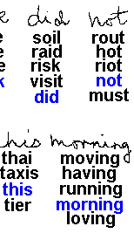
Recognition
Handwriting

Slide 58
Drawbacks
Low bias means it’s easy to overfit
Requires much more data to be accurate
“Model” keeps the entire dataset!

Slide 59
K-nearest Neighbors

Slide 60
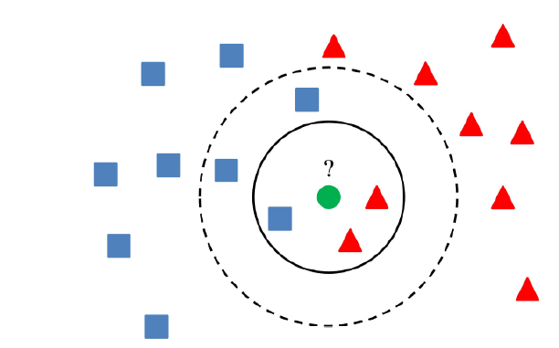

Slide 61
Pros of KNN
Simple to understand, no training step
Can do regression or classification
Easy to do multi-class classification
Easy to add new data

Slide 62
Cons of KNN
Numerical inputs only
Major problems with imbalanced data
Model slows down with more data

Slide 63
Distance &
Dimension

Slide 64
Distance-Based ML
K-Nearest Neighbors
Linear Regression
Polynomial Regression
etc

Slide 65

Review
Distance

Slide 66
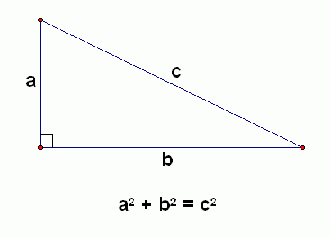

Slide 67
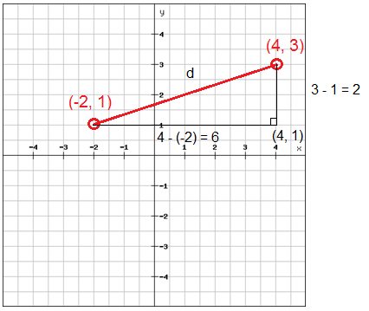

Slide 68
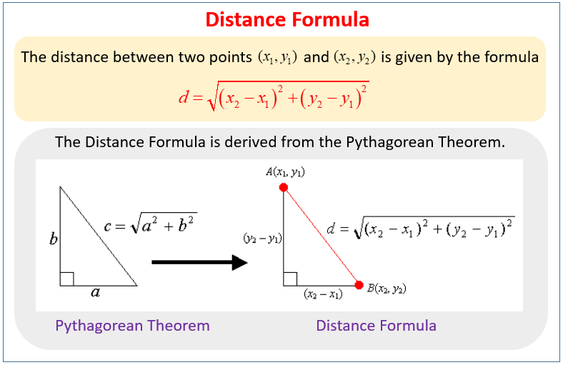

Slide 69
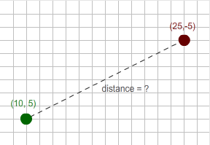

Slide 70
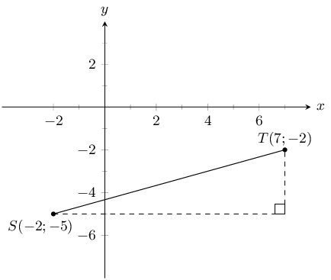

Slide 71
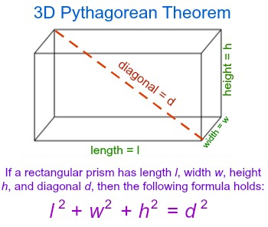

Slide 72
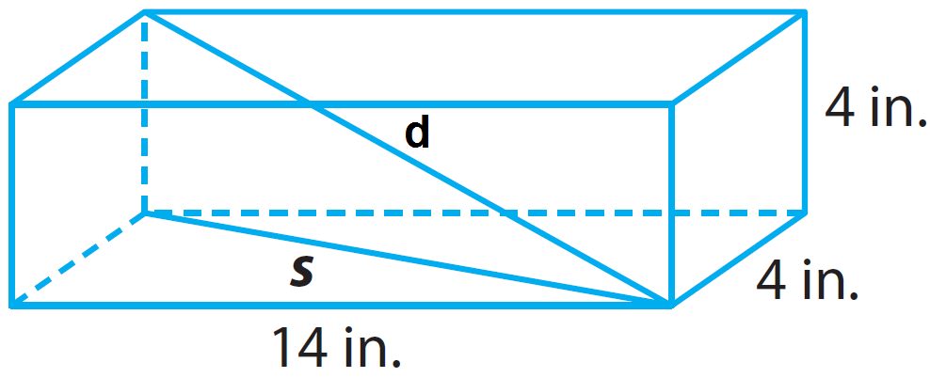

Slide 73
Dimension
Degrees of freedom
How many numbers to specify a location?

Slide 74
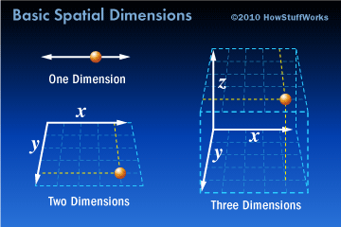

Slide 75
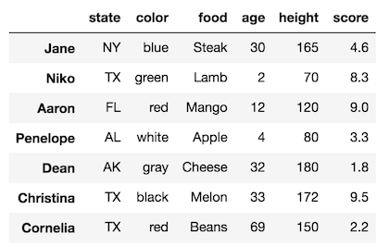
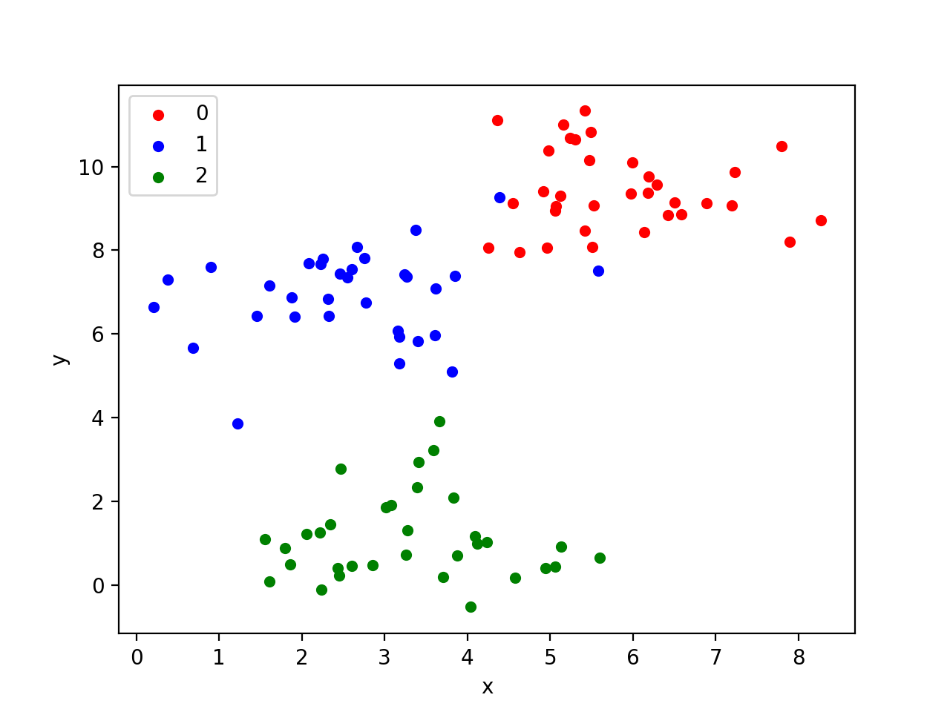

Slide 76
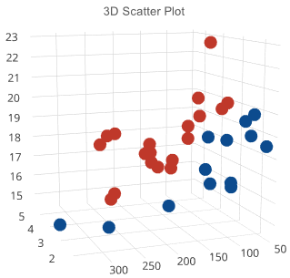

Slide 77
?

Slide 78
Exercises

Slide 79
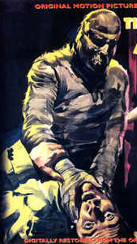
Dimensionality
the curse of

Slide 80
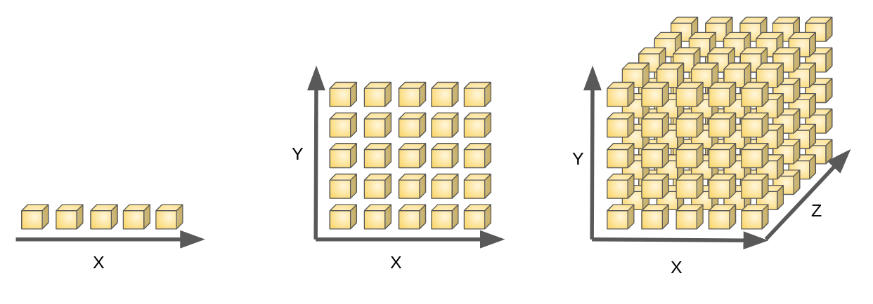

Slide 81
